Slide 1
#DontBeASugarDaddy
Sedef Selcan Özcan & Selda Öztürk

Slide 2
Background
In Turkey, 43% still believe a woman’s primary role is to be a ‘good mother and wife’
4/10 women
leave their jobs after marriage and childbirth*
Source: https://www.kariyer.net/ik-blog/calismak-ya-da-calismamak-bebek-dogduktan-sonra-yasanan-kaos/?utm_source=chatgpt.com

Slide 3
Problem in a Nutshell
CHILDREN
AT HOME
$
SOCIETY’S NORMS
ECONOMIC
CONDITIONS
WOMEN
AT HOME
MEN
AT WORK

Slide 4
Target Audience
Easier To Persuade
Women aged 25-40
Mothers that had to quit workforce due to lack of shared parental duties at home
Men aged 25-40
Fathers who are financially supporting their families but have limited involvement in childcare or household chores

Slide 5
Insight& Creative Idea:
#DontBeASugarDaddy
SUGAR DADDY: n.
A wealthy older man who provides financial support to a younger person, typically in exchange for companionship.
“SUGAR DADDY”: n.
A father who,
i) financially supports his family
ii) but avoids childcare and household responsibilities, not actively participating in raising his children.
If you only contribute financially, you’re not a father. You’re a Sugar Daddy.
If you only do the fun parts of parenting, you’re not a father, you are a “Sugar Daddy”.
So, #DontBeASugarDaddy!

Slide 6
#DontBeASugarDaddy
Campaign Strategy
CREATE AWARENESS
MAXIMIZE REACH w/ SHAREABLE CONTENTS
CREATE
REAL IMPACT

Slide 7
Real dads don’t just pay the bills and spend short cherish moments with their children.
They raise the kids.
#DontBeASugarDaddy
#DontBeASugarDaddy
Big Idea &
Hero Film
4 out of 10 mothers in Turkey leave their jobs after having a child – not by choice, but because they’re left alone with childcare.

Slide 8
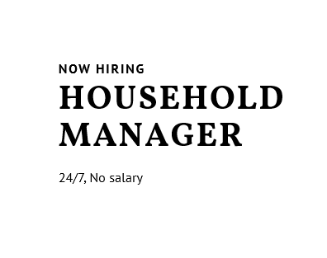
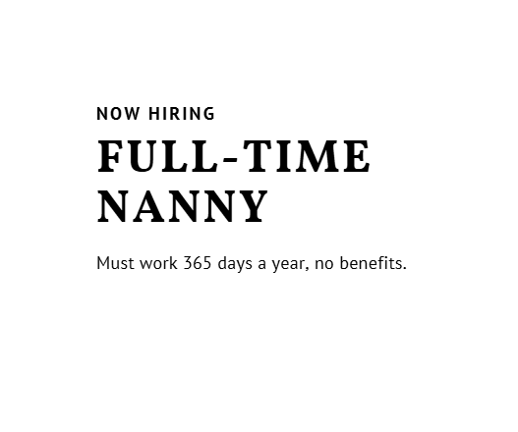
#DontBeASugarDaddy
Execution
Johnson’s Baby “Dad Duty” Exclusive Range
Guerrilla Digital / PR Activation
Viral TikTok Challenges
“Yes, You Can Bathe a Baby” Shampoo
“Your Turn to Soothe.” Lotion
Disruptive Exclusive Range with sarcastic on-pack communication
Would You Hire Her?
Creating fake job ads on career sites
3:00am Challenge
Male creators do the night feed for a week

Slide 9
#DontBeASugarDaddy
Execution
Real Impact
The Workforce Fund
Percentage of portfolio sales funds
childcare financial support & training for couples to emphasize daycare as a smart option

Slide 10
#DontBeASugarDaddy
1.5M $ marketing campaign budget
45M impression in total
Budget & Timeplan
May
Jul
Sep
Kick-off the campaign by creating awareness around the main idea w/ 15” hero film
Production: 25K $
Media: 1000K $ (TV + digital)
Send “Dad Duty” Kit to dad influencers & invite them to Tiktok challenge
Influencers & PR kits:
300K $
Create a fund w/ 10% dad duty product range sales
Fund: 160K $ (3-months sales)
Launch Johnson’s Baby
“Dad Duty” Product Range
Packaging: 10K$
In digital, maximize reach w/ Tiktok challenge videos + fake job ads
Digital & PR: 150K$
As a real impact; educate society w/ “smart option: daycare” seminars & provide financial support for parents who want to send their children to daycare via NGOs
Seminars: 10K $
Financial support: 150K $
Jun
Aug
Oct

